Slide 1
SEMANTIC WEB MINING:
FIND ARs in Linked Open Data Sets
By-
Bryceleen D’souza(7057)
Leon Suraj D’souza(7058)
Mugesh Nadar(7087)
-Under Mentor Prof. Swati Ringe

Slide 2
INTRODUCTION
What is Semantic Web?
What is linked data?
What are association rules?

Slide 3

Semantic Web?Huh?
Web 3.0
Promotes Common Data Format for exchange of information.
Promotes Open Formats →
Aims to make the Web a Machine Readable Entity

Slide 4
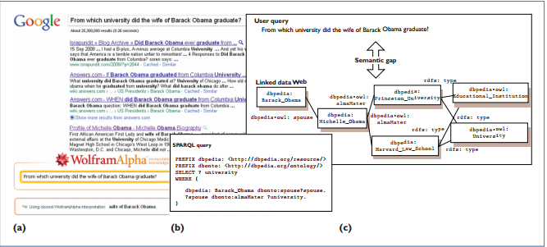
MIND THE GAP!

Slide 5
Problem Statement
An algorithm, named SWApriori, has been proposed which has considered the above challenges and without the end user involvement, mines ARs directly from a single semantic web dataset. The problem statement includes collecting and connecting them so that all data appear as a single and central dataset and then using existing methods to mine ARs from the generated dataset.

Slide 6
LITERATURE SURVEY
Association Rule Mining (ARM) algorithms are of two types : Apriori based and FP-based.
LD datasets are convertible to directed graphs but this is not suitable for ARM
However, ARs are mined now from semantic web data using mining patterns the user provides based on SPARQL.

Slide 7
LITERATURE SURVEY
Conversion into graphs doesn’t work because unlike traditional methods, TRANSACTIONS are not well defined entities in the Semantic Web
Also Graph vertices are unique and discovering sub-graph redundancy is really not possible

Slide 8
SCOPE
Preliminary experiments have been performed on this semantic data showing promising results and proving the efficiency, robust, and usefulness of the used approach.
Knowledge representation of the web.
Integration of databases in the knowledge web.
Scalability of knowledge-intensive web services

Slide 9
Description
Use following slides for discussing status, schedules, budget, etc.
-for more info…
List location or contact for specification (or other related documents)

Slide 10
Competitive Analysis
Competitors
You may want to allocate one slide per competitor
Strengths
Your strengths relative to competitors
Weaknesses
Your weaknesses relative to competitors

Slide 11
Competitive Analysis, Cont.
Competitors
Strengths
Weaknesses
-for more info…
List location or contact for competitive analysis (or other related documents)

Slide 12
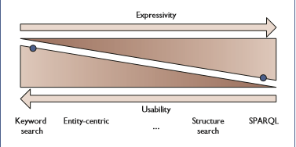
Technology
SPARQL, Jena
SPARQL allows to query Ontologies, Data Sets while Jena provides the Java Powered platform independency required.

Slide 13
Team Resources
State assumptions about resources allocated to this project
People
Equipment
Locations
Support & outside services
Manufacturing
Sales

Slide 14
Procedures
Highlight any procedural differences from usual projects of this type
Discuss requirements, benefits, and issues of using new procedures
-for more info…
List location or contact for procedures document (or other related documents)

Slide 15
Schedule
Review high-level schedule
-for more info…
List location or contact for detailed schedule (or other related documents)

Slide 16
Current Status
High-level overview of progress against schedule
On-track in what areas
Behind in what areas
Ahead in what areas
Unexpected delays or issues

Slide 17
Related Documents
Marketing plan
Location or contact name/phone
Budget
Location or contact name/phone
Post-mortem
Location or contact name/phone
Submit questions
Location or contact name/phone

Slide 18
Proposed Solution
Selecting Domain
Selecting DataSet
Connecting DataSet
Ontology mapping
Duplicated Data
Applying Algorithm

Slide 19
SWApriori Algorithm

Slide 20
SWAPrior
Inputs:
Dataset
Minimum Support
Minimum Confidence
Outputs:
Large Data-Item
Association Rule

Slide 22
Generate2 Large DataItem
Inputs:
List of object info instances
Minimum Support
Outputs:
List of large Itemset

Slide 24
Generate2 Large DataItem
Inputs:
All large itemset
Minimum Confidence
Outputs:
Association Rules

Slide 26
Technologies to be Used
Java
Jena Fuseki
OWL, Turtle, RDF
Protege

